Slide 1

``Summer Internship Report
on
CHAT WITH PDF
DEPARTMENT OF COMPUTER SCIENCE AND ENGINEERING,
SCHOOL OF ENGINEERING AND TECHNOLOGY
Submitted by
Name: Harsh Kaushik
Roll No: 21CSU182

Slide 2

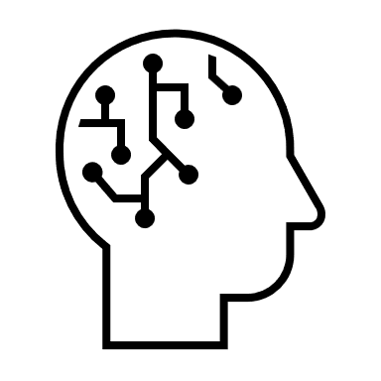
INTRODUCTION
During my internship, I worked on developing an AI-driven chatbot designed to analyze and extract information from PDF documents. The project aimed to enhance document management efficiency by enabling users to interact with the chatbot through natural language queries. Utilizing advanced AI and NLP techniques, the solution was developed and deployed on AWS cloud infrastructure to ensure scalability and accessibility.

Slide 3

PROJECT GOALS
Develop
Develop an AI-powered solution for parsing and understanding PDF documents.
Enable
Enable user interaction with the chatbot for efficient information extraction.
Deploy
Deploy the solution on cloud infrastructure for scalability and accessibility.

Slide 4
Focus Areas
Advanced AI and NLP techniques for document analysis.
Cloud deployment for enhanced scalability and accessibility.
User-friendly interface development.

Slide 5
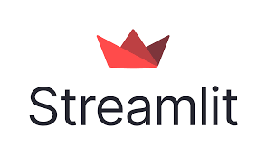


Technologies Used:
AI Models: Amazon Titan and Claude 2.1
Interface: Streamlit
Cloud Services: AWS (EC2, S3)
Containerization: DockerHub

Slide 6
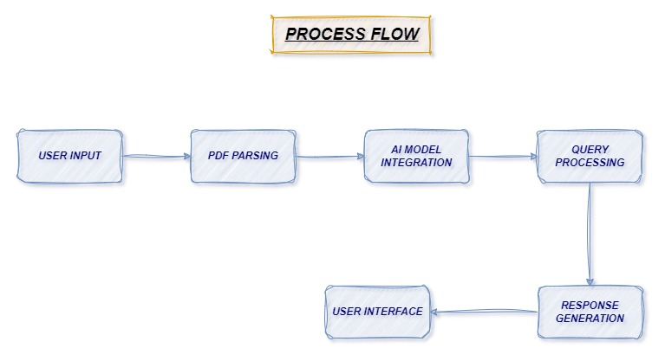
Amazon Titan and Claude 2.1 models process the extracted text Perform entity recognition and keyword extraction
Chatbot processes user queries and match queries with relevant information extracted from the PDF
User uploads PDF and submits Natural Language Query
Extract text and metadata from PDF using Python libraries
Display responses to the user via Streamlit interface and provide options for additional queries or actions
Generate responses based on the processed information and Ensure relevance and accuracy of responses

Slide 7
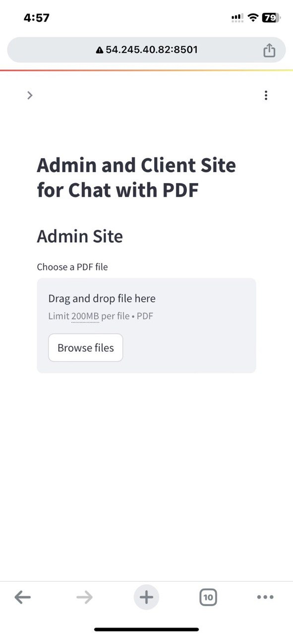
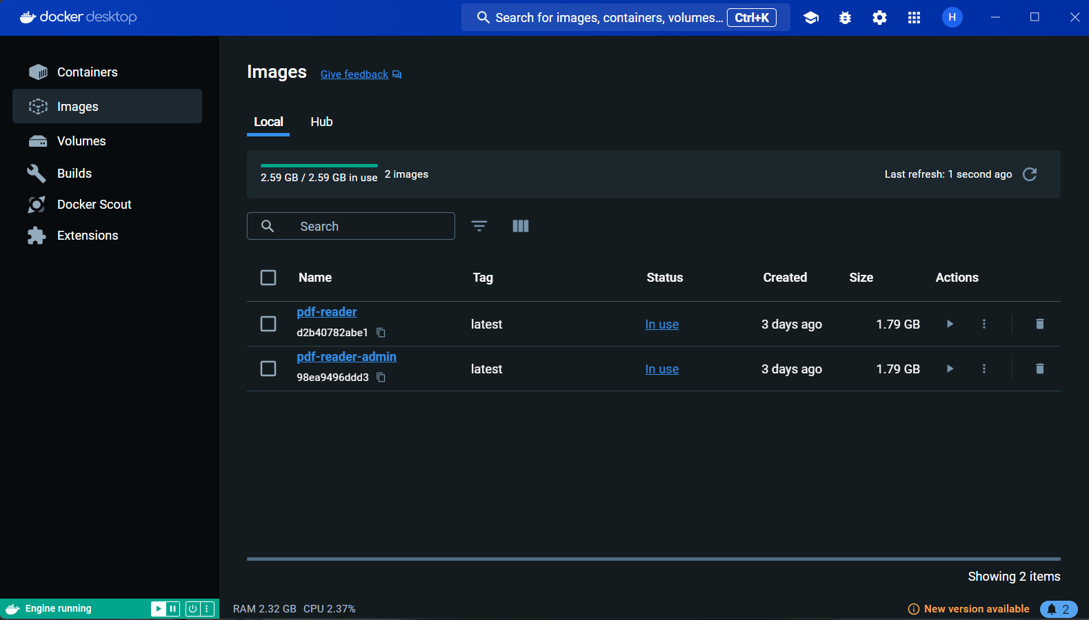
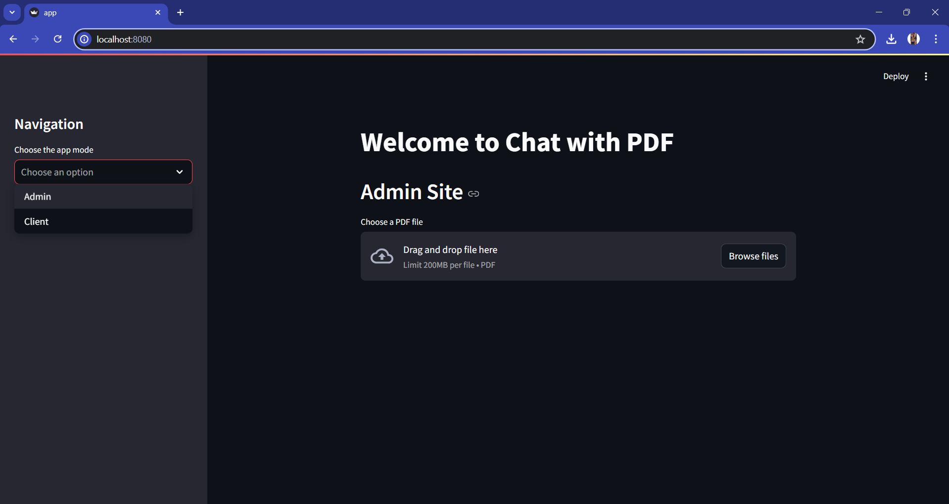
Docker Images
Running on Localhost
Running on Cloud

Slide 8
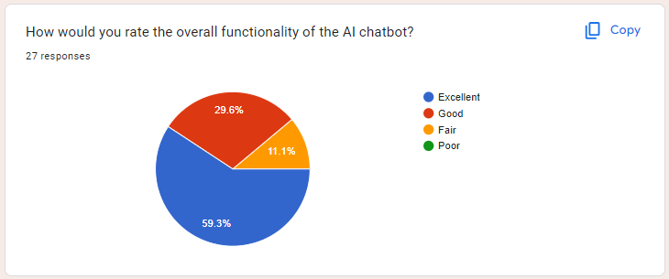
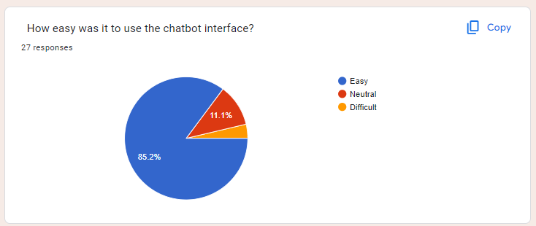
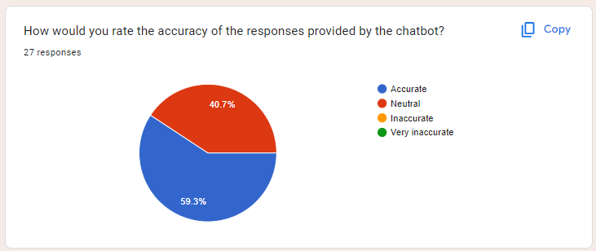
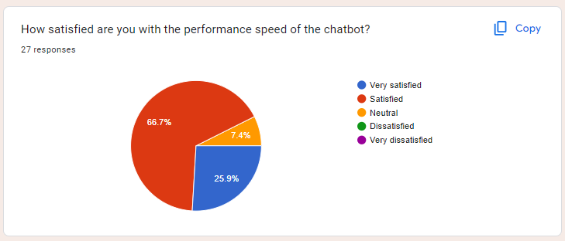
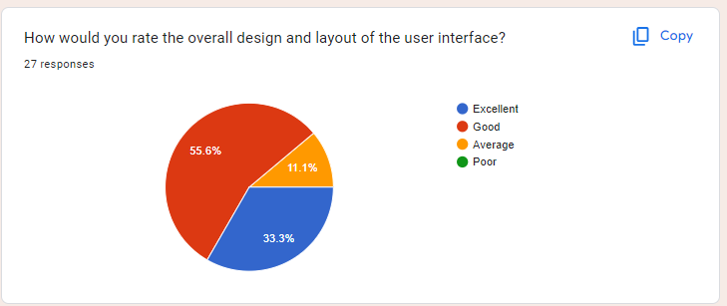
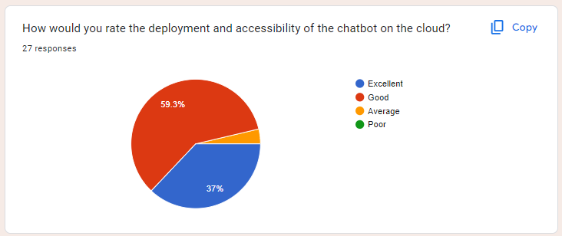
FEEDBACK

Slide 9

BENEFITS
Efficiency - The chatbot effectively simplifies document management and retrieval processes.
Scalability - The cloud-based deployment ensures the solution is accessible and scalable.
User Experience - The user-friendly interface allows for easy interaction and query processing.

Slide 10
KEY LEARNINGS
Technical Skills - Gained hands-on experience with AI models (Amazon Titan, Claude 2.1), cloud services (AWS), and development tools (Streamlit, DockerHub).
Project Management - Enhanced my ability to plan, execute, and deploy complex projects efficiently.
Collaboration - Improved teamwork and communication skills through collaboration with the R&D team.

Slide 11
THNAK YOU !!
ANY QUESTIONS ?

